Slide 1
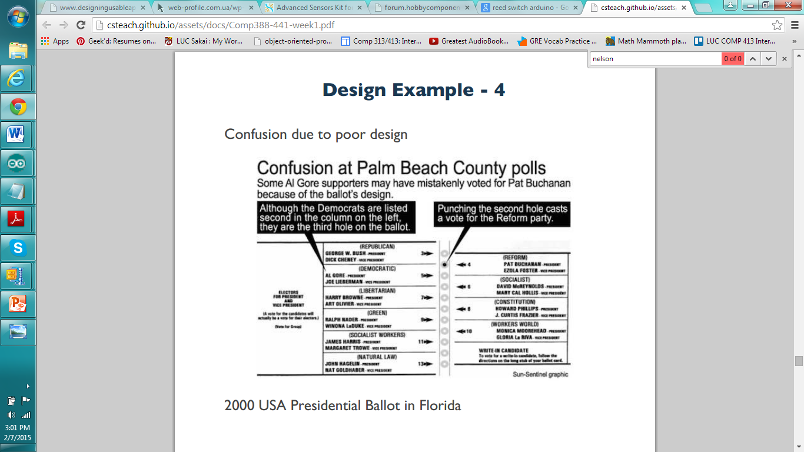
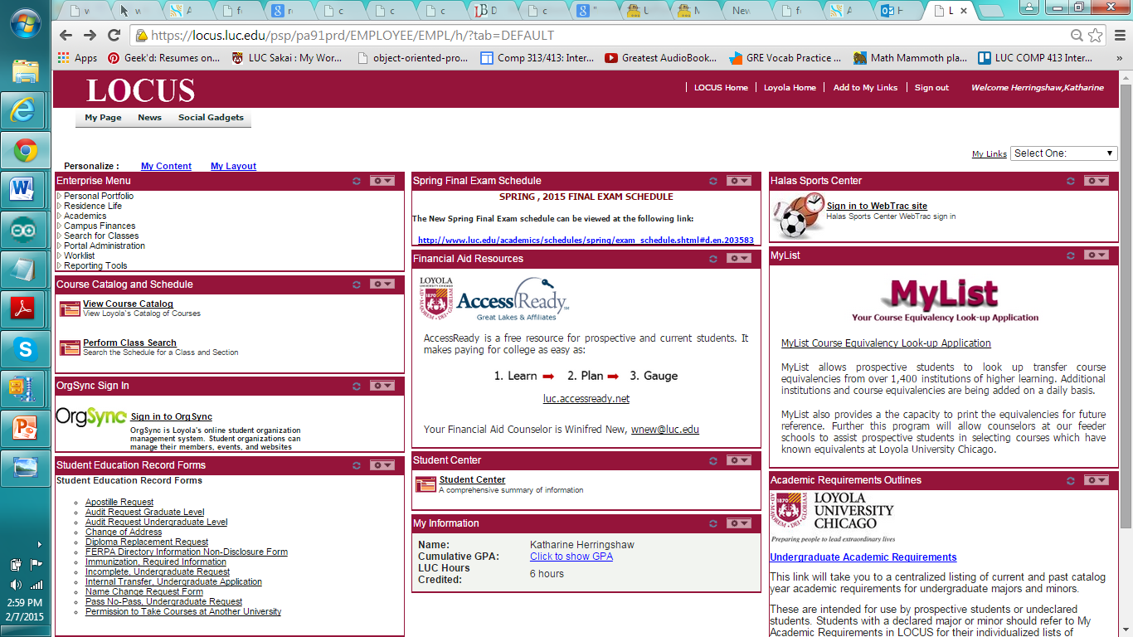
Why Locus?
Cluttered.
It’s hard to find what you are looking for.
Nothing really pops out.
Similar Issue:
Confusing to the
user.

Slide 2
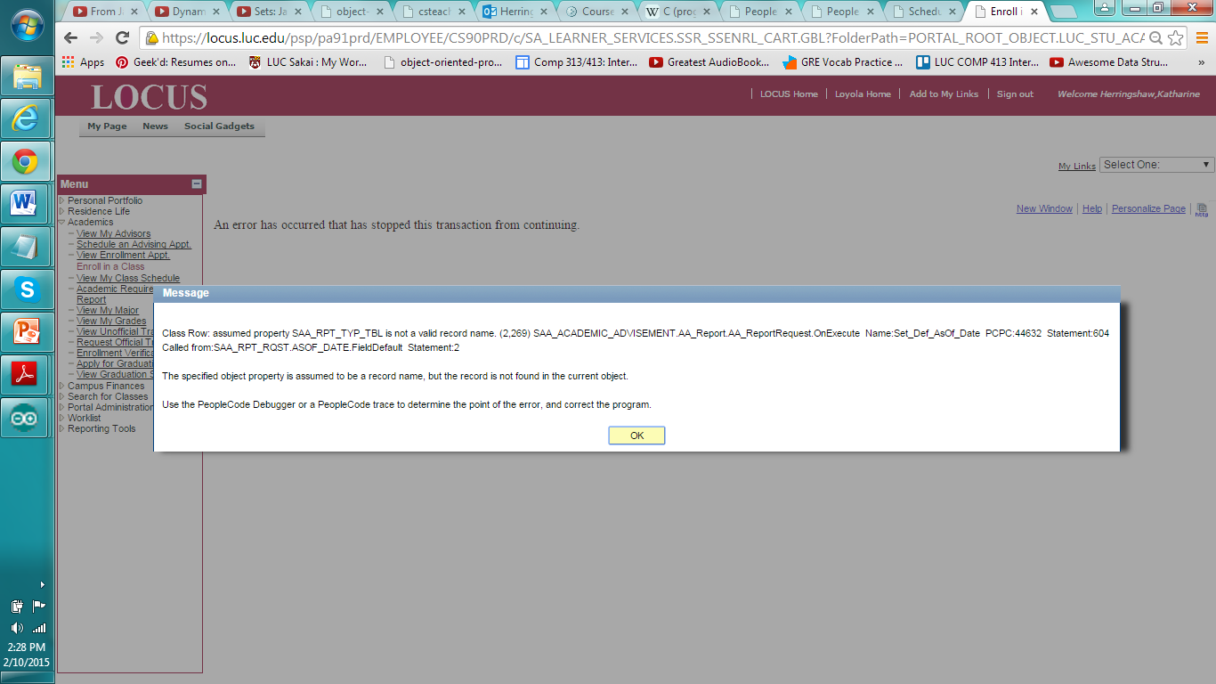
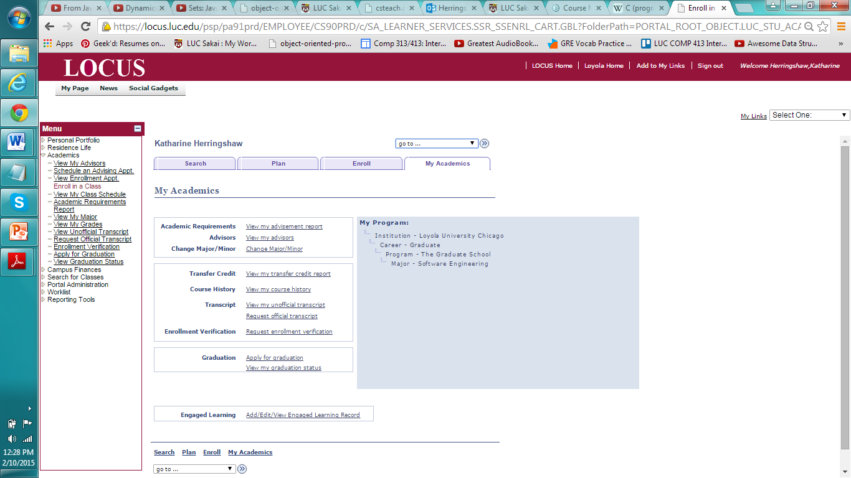

LOCUS - Difficult to Navigate
Not cohesive.
Some screens do not provide the information you would expect.
Links lead to nowhere and in some cases result in an error message.
Hard to navigate.
Really?

Slide 3
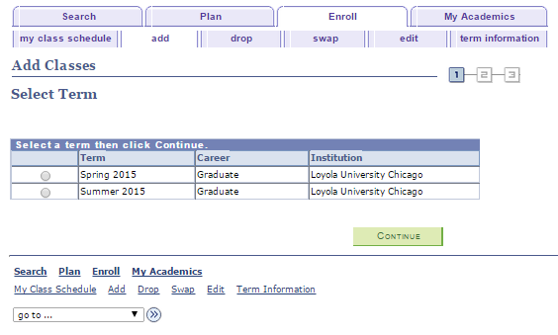
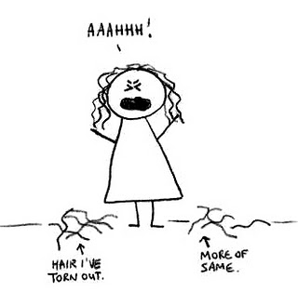
LOCUS - Complex Mental Model
Complexity of the system
UI should be significantly streamlined and simplified
There is a large disconnect between the design model and user model.
It’s virtually lacking in a thoughtful design pattern which just leads to frustration for the user.

Slide 4
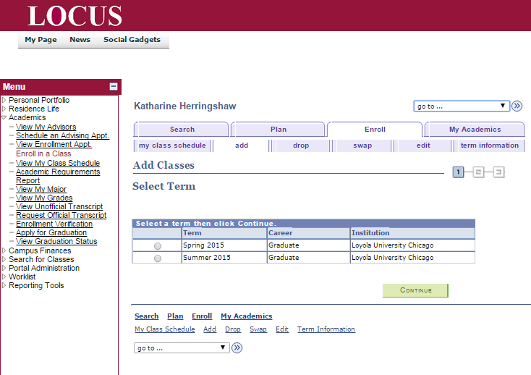

LOCUS - Use of Color
Color currently is not being used effectively in LOCUS.
LOCUS uses a muted color scheme.
Visual representations will be added to guide the user.
Colors and icons will be used in conjunction to ensure clarity.

Slide 5

LOCUS - Memory “Overload”
Simplify and guide navigation. Change options and actions to representative naming.
Reduce cognitive load by reducing required background knowledge.
Reduce cognitive load by showing draft schedule.
Add graphical representations and icons to aid in creating memory hooks.

Slide 6
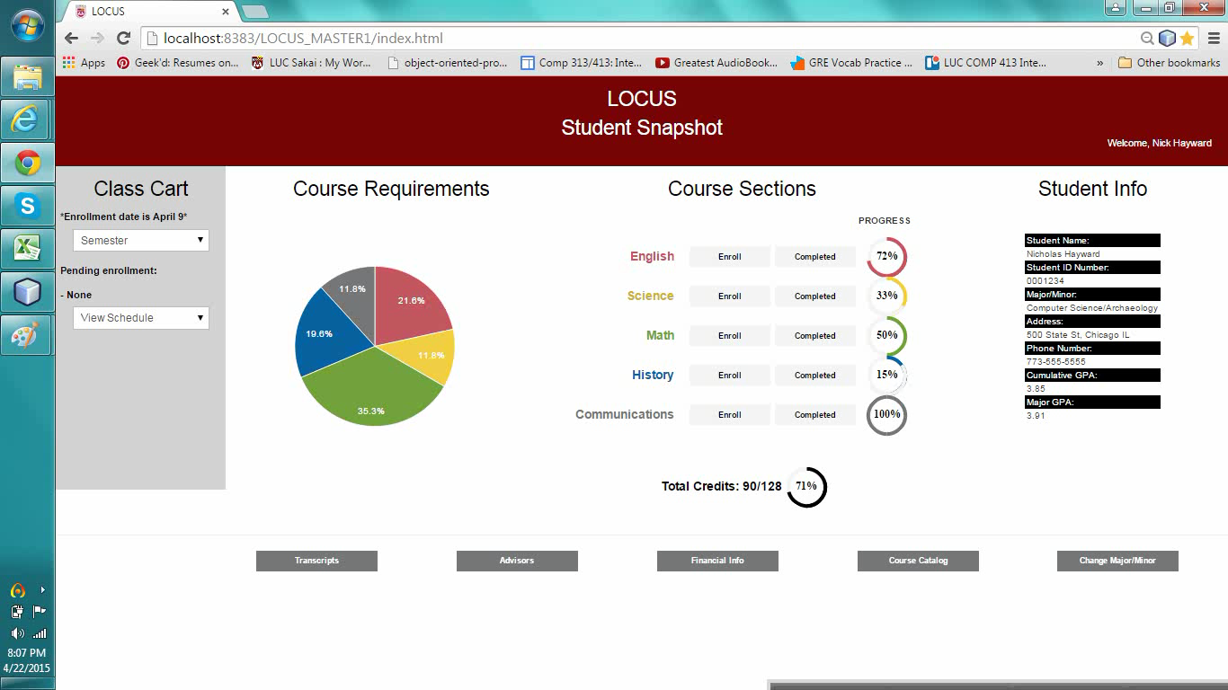
Student Snapshot Tutorial

Slide 7
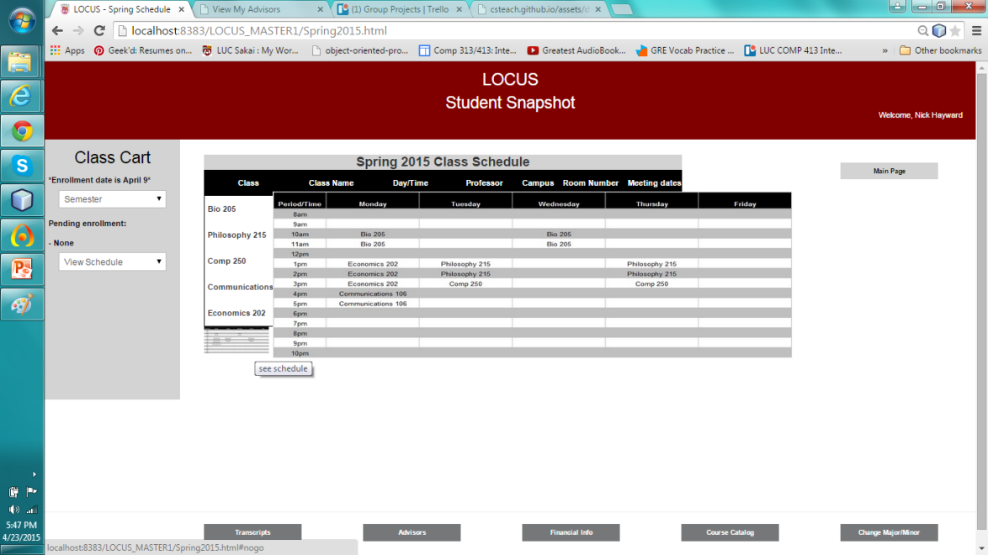
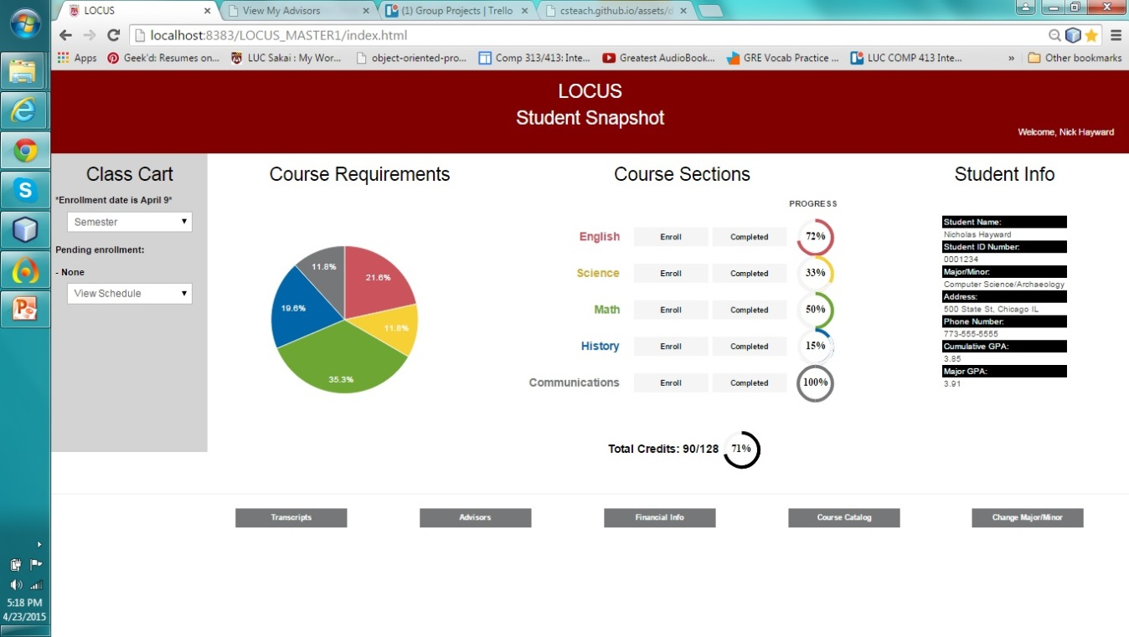
Student Snapshot Feedback
Feedback highlighted areas of main confusion
Designed alterations based on that feedback
Final designs were highlighted for clarity and ease of comprehension

Slide 8
Student Snapshot Testing
Made testing a high priority
Conducted two rounds of testing in total with a diverse group
After first round, used feedback to determine the most essential elements to be included
Second round of testing, feedback was geared more toward design aspects

Slide 9

Student Snapshot Testing

Slide 10
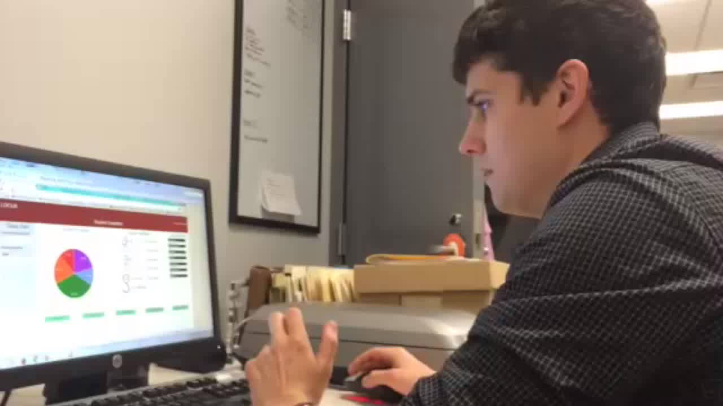
Student Snapshot Testing

Slide 11

Student Snapshot Testing

Slide 12
Student Snapshot Wrap-up
Employs the principles of good design
Hierarchy, poor navigation map, redundancies
Graphical interface mitigates the problems of current design

